Slide 1

MEMORY WITH A RECEIPT
Organizational Memory Auditor
Every answer carries the evidence, the conflict, and the way back.
RELEX Challenge · AaltoAI Hackathon 2026

Slide 2

WHY MEMORY BREAKS
A clean summary can still be wrong when the archive disagrees with itself.
45 files, one messy truth
Transcripts, email threads and status reports — with people, dates and decisions changing over time.
Suggestion ≠ commitment
A polished assistant can turn an idea into an agreement if nobody checks the receipt.
Stale ≠ false
A later report may be superseded by operational evidence — or contradict it. Newer is not automatically truer.
Privacy ≠ amnesia
Remove a person from ordinary surfaces without deleting the organization's attributable history.
The challenge: answer live questions with a receipt — then survive the privacy test.
AALTOAI HACKATHON 2026
MEMORY WITH A RECEIPT
2

Slide 3
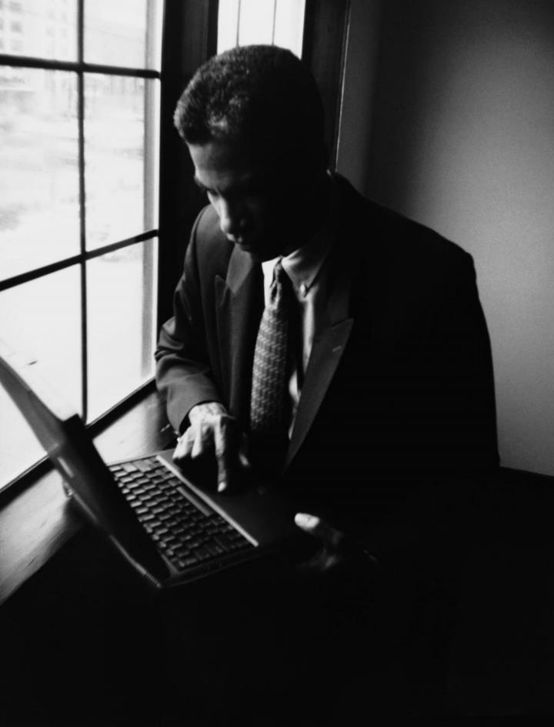
THE ANSWER IS A CASE — NOT A CHAT
Every question becomes a structured ruling.
1
ASK
Hybrid search finds the right moments — not the whole archive.
2
CHECK
Risk rules decide when the first answer needs a real challenge.
3
RECONCILE
Conflicts, uncertainty and Decision Evolution stay visible.
4
RECEIPT
Claims link to exact stored evidence — metadata comes from the locker, not the model.
The LLM interprets. The Evidence Locker remembers.
AALTOAI HACKATHON 2026
MEMORY WITH A RECEIPT
3

Slide 4

ROADMAP & SEAMLESS EXECUTION
We planned for evidence first — and shipped the whole loop in that order.
1 · LOCK THE MEMORY
2 · BUILD THE AUDITOR
3 · PROVE THE EDGES
45 source files
→ 2,534 atomic Evidence Units
→ stable, citable IDs
Retrieve
→ challenge
→ reconcile
→ validate
490 passing tests
+ privacy/reversal rehearsal
+ live demo path
PLAN → BUILD → VERIFY → DEMO
What the judge sees: one coherent product, not a collection of promises.
AALTOAI HACKATHON 2026
MEMORY WITH A RECEIPT
4

Slide 5

THE EVIDENCE LOCKER IS THE MEMORY
Raw evidence is authoritative; model output is a derived interpretation.
45
2,534
490
source documents
citable evidence units
automated tests
PROPOSE
CHALLENGE + RECONCILE
VALIDATE
Decision Evolution keeps the path visible: proposed → agreed → contradicted → superseded → current.
No citation, no claim. No valid citation, no screen time.
AALTOAI HACKATHON 2026
MEMORY WITH A RECEIPT
5

Slide 6
THE RADAR: INITIATIVE THAT LOOKS AHEAD
A proactive feature that turns hindsight into a ranked reason to look again.
REJECTED /
DEFERRED IDEA
ORIGINAL
BLOCKER
WHAT
CHANGED?
RADAR
ASSESSMENT
What did we stop?
Why did it stop?
Does the blocker still hold?
Revisit · blocked · unclear
7 skeptical checks keep hindsight honest — and the Radar never pretends it is evidence.
No prompt required. No unsupported recommendation. Just the next question worth asking.
AALTOAI HACKATHON 2026
MEMORY WITH A RECEIPT
6

Slide 7

REVERSIBLE PSEUDONYMIZATION
Privacy without erasing organizational memory.
PRESERVE
PROTECT
RESTORE
Every evidence unit, relationship, receipt and profile survives.
Names become a stable alias — Participant Q7M4-N8 — while the original identity stays in an encrypted reversal vault.
An authenticated admin can reverse it, rebuild the indexes, and verify every surface.
Source · search · embeddings · cases · cache: rebuilt, rechecked, and never filtered at query time.
The person changes name in the product — not history in the archive.
AALTOAI HACKATHON 2026
MEMORY WITH A RECEIPT
7

Slide 8

NOT JUST ANOTHER CHATBOT
The difference is accountable memory — not more fluent prose.
TYPICAL CHATBOT
OUR AUDITOR
Best-effort prose
Typed Case with a status
One answer
Evidence + objections + uncertainty
Latest statement wins
Decision Evolution shows supersession
Forget by filtering
Pseudonymise, preserve, verify
Waits for a question
Radar surfaces what to revisit
A chatbot answers. An auditor can defend the answer.
AALTOAI HACKATHON 2026
MEMORY WITH A RECEIPT
8

Slide 9
THE LIVE STORY IN 60 SECONDS
One question. One evidence trail. One controlled way to forget responsibly.
1
2
3
4
5
6
ASK
OPEN
EVOLVE
RADAR
ALIAS
RE-ASK
Did Acme sign off UAT?
Exact turn in context
Proposal → current state
What should we revisit?
Pseudonymise one person
History intact
Same archive. New answer. Zero amnesia.
AALTOAI HACKATHON 2026
MEMORY WITH A RECEIPT
9

Slide 10

WE BUILT MEMORY THAT CAN EXPLAIN ITSELF — AND FORGET RESPONSIBLY.
A receipt for every conclusion.
A controlled way back.
A product that does more than chat.
Thank you · Questions welcome
RELEX Challenge · AaltoAI Hackathon 2026

